Slide 1
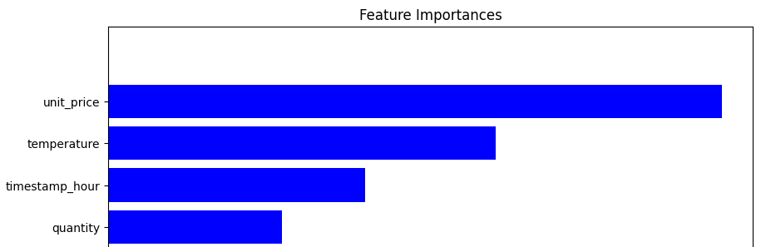
Summary Of Feature Importance

Slide 2
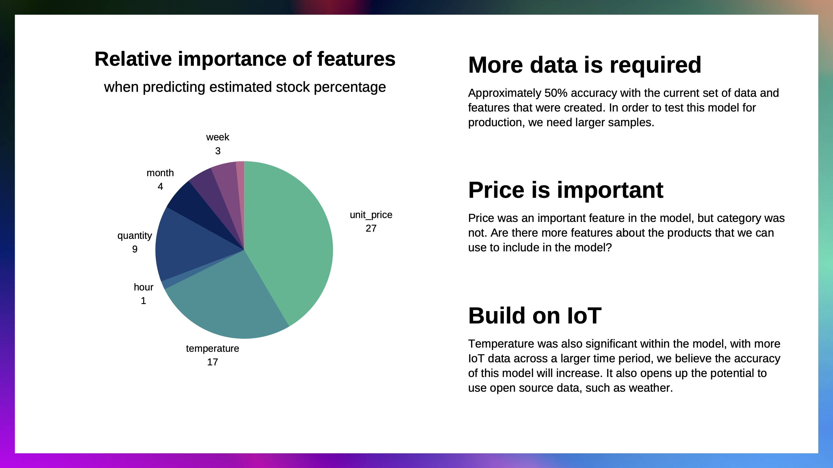
Summary Of Feature Importance

Slide 3
Summary Of Predictions
This feature importance visualisation tells us:
- The product categories were not that important
- The unit price and temperature were important in predicting stock
- The hour of day was also important for predicting stock
With these insights, we can now report this back to the business

